Slide 1

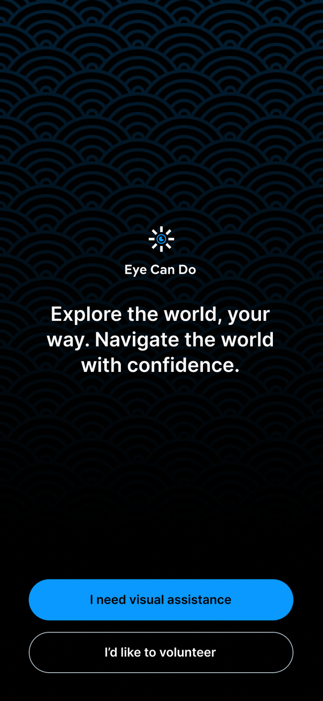

Eye Can do
Enhancing Independence through Real-Time Recognition
TEAM NAME: PSYDUCK

Slide 2

Problem Statement
R1 - Enhancing Object Recognition for the Visually Impaired (SDG-3)
Visually impaired individuals face challenges in recognizing objects, people, and places.
Current tools provide limited assistance, highlighting the need for more intuitive solutions.
Significant challenges in daily activities due to lack of effective recognition tools.
Current solutions often lack real-time capabilities and intuitive user interfaces.
Objective: Develop an offline mobile application for real-time object, person, and place recognition.

Slide 3
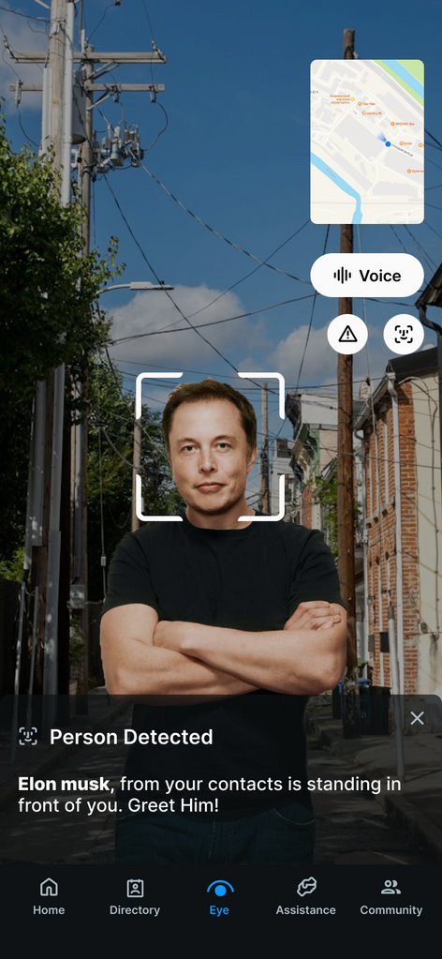
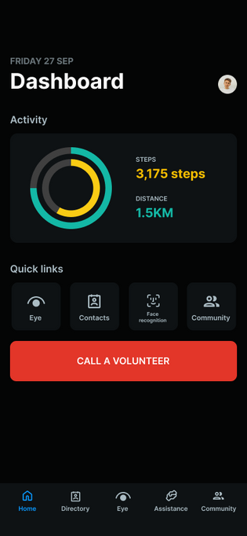

Our
Solution
Eye Can Do is an offline all-in-one assistive platform that empowers visually impaired users with tools for independence, real-time assistance, and community connection.
Navigating the app through voice commands.

Slide 4

Who can use this?
User - The primary users are visually impaired individuals seeking to improve their independence and safety in daily activities.
01
Volunteer - Secondary users could include caregivers or family members of visually impaired individuals who want to provide additional assistance.
02

Slide 5
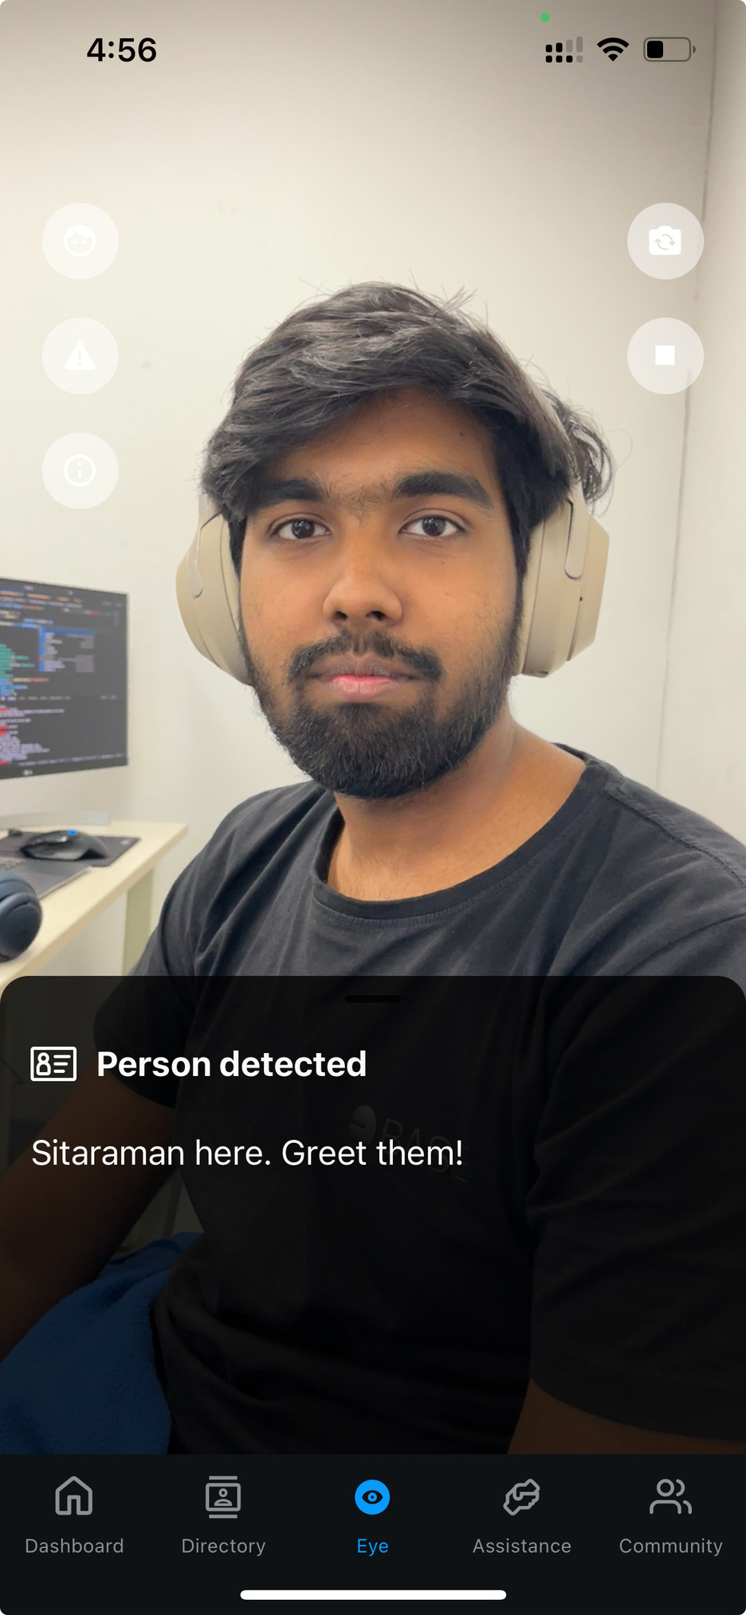

Indoor Mode
Face Recognition
Helps the user to recognize nearby people by face recognition model trained on custom dataset from scratch
01
Less Inference Time < 0.6 sec
Without any pre-training
02
Face Recognition library is used to create embeddings and K Nearest Neighbours is used for face recognition
02

Slide 6
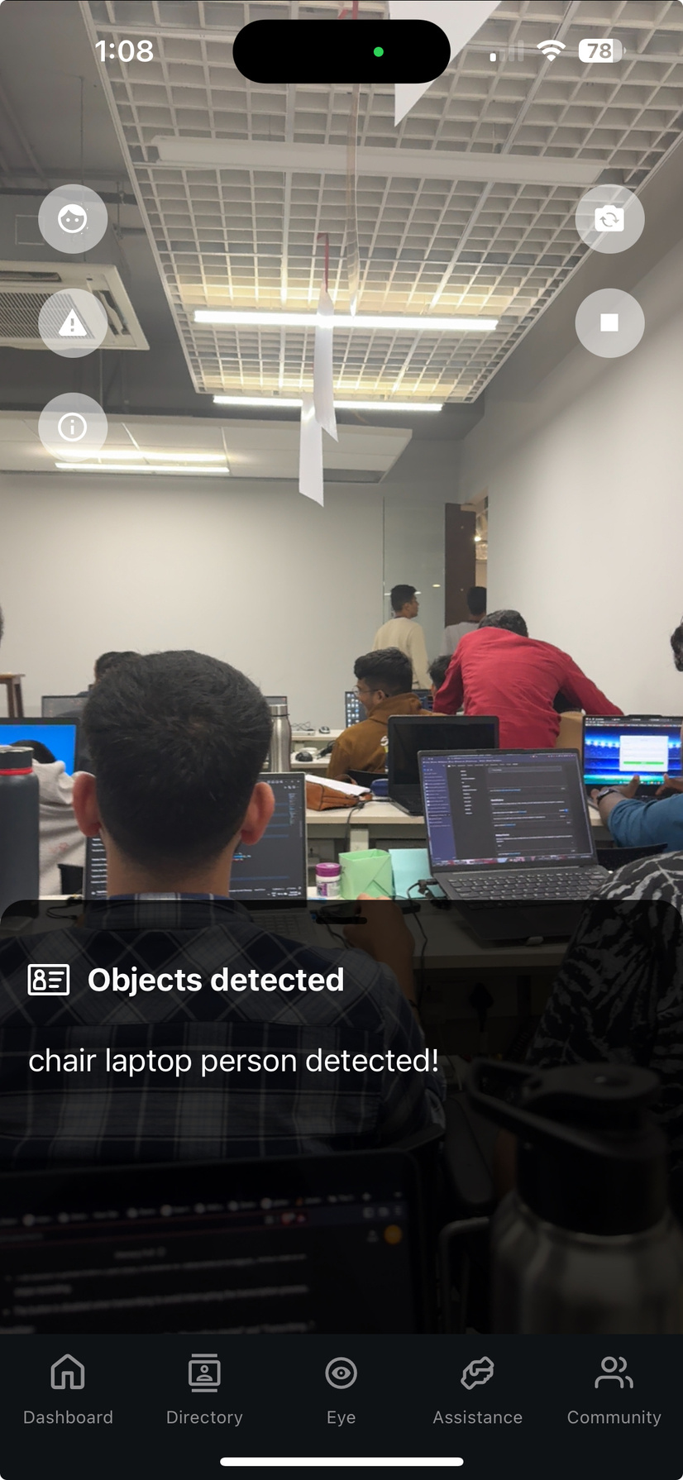
Outdoor Mode
Object Recognition
01
Scene Awareness: Helps visually impaired people to understand their surroundings by identifying objects
02
App uses YOLO v3 for fast and accurate real time object recognition
Presentations are communication tools that can be used as demonstrations, lectures, speeches, reports, and more.
03
04
YOLO v3 is lightweight and suitable for seamless integration in mobile applications

Slide 7
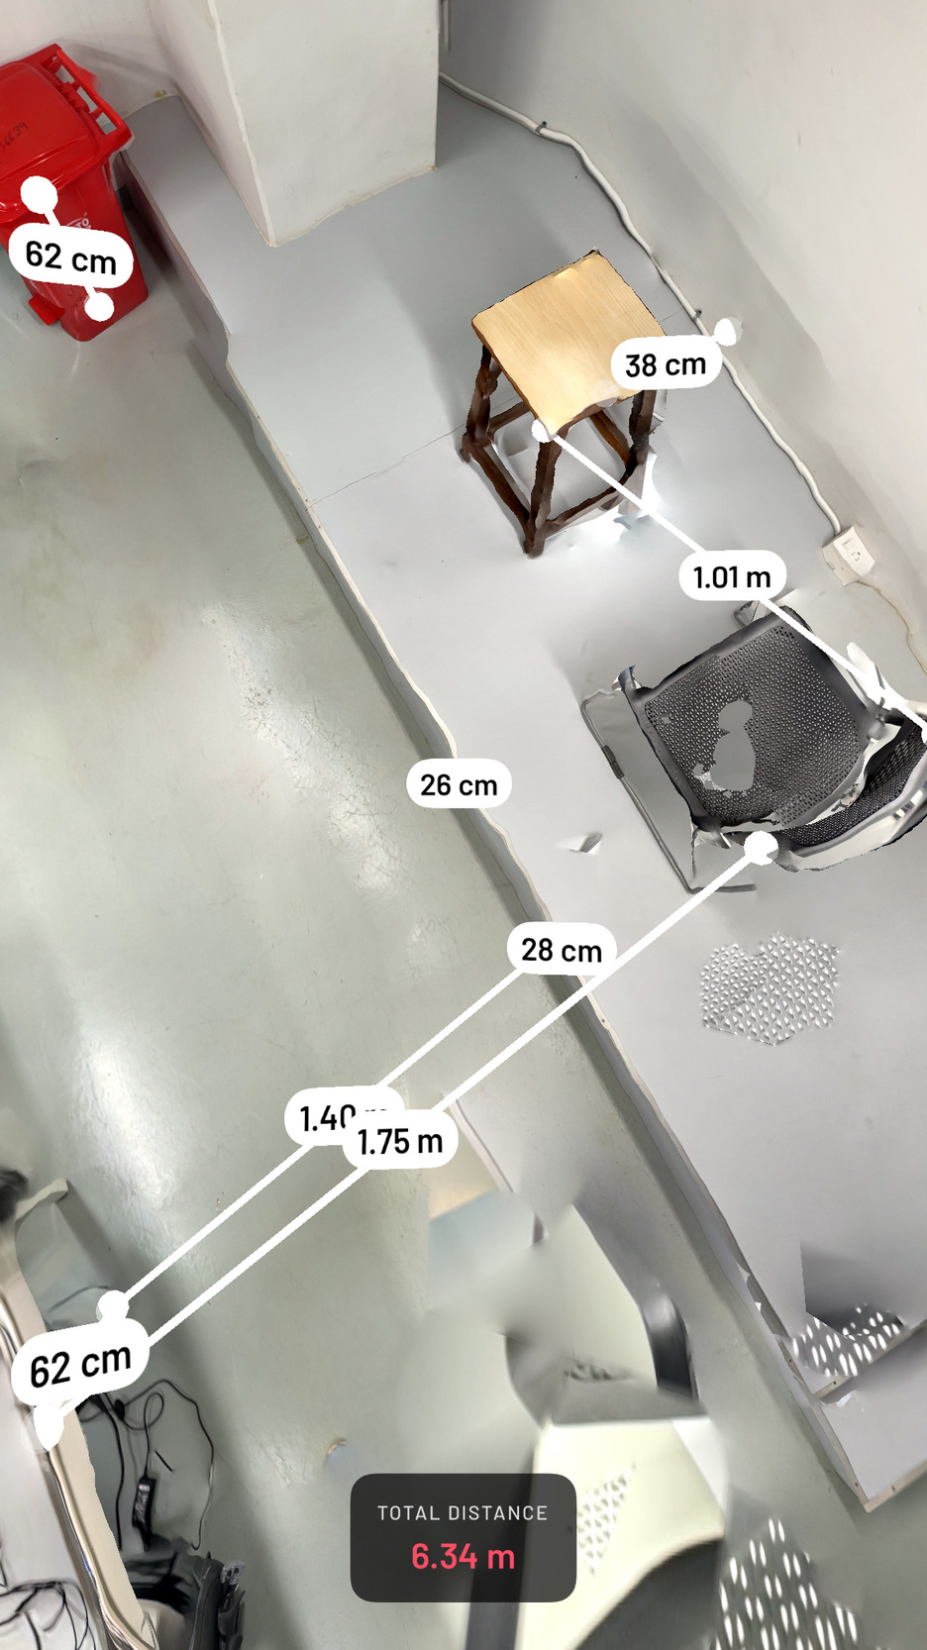
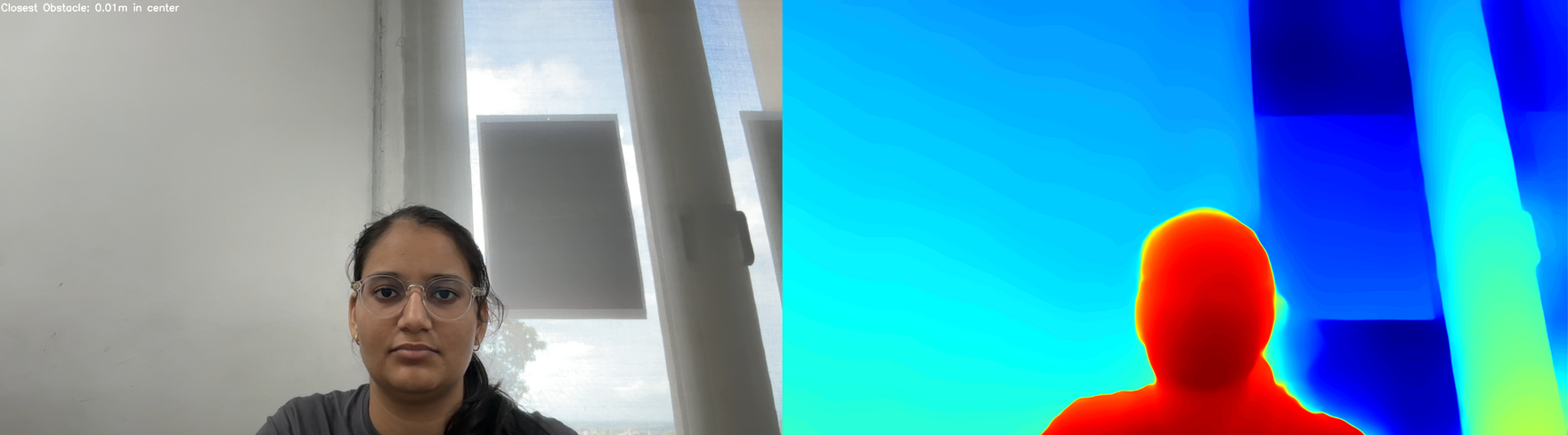
Street Mode
Depth Estimation
Helps the user to detect any obstacles on the way and gives information about the direction and distance of obstacle i.e.- left, right and center
01
02
Uses Depth Anything model for relative depth estimation
02

Slide 8
Point cloud for distance estimation

Slide 9
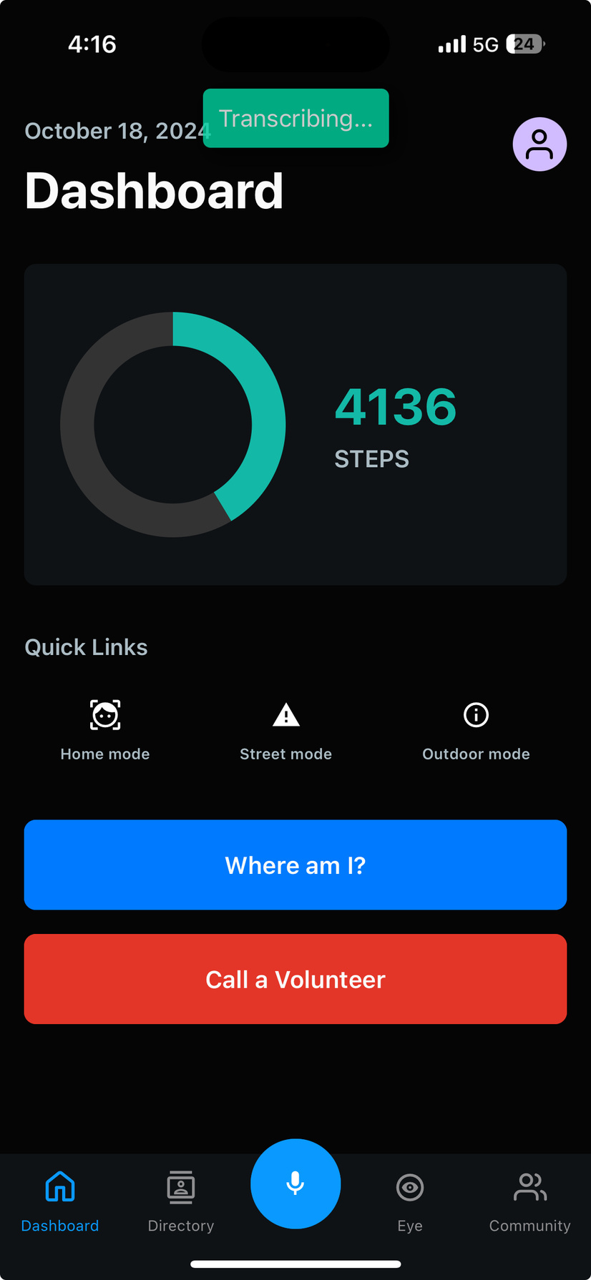
Voice Navigation
Hands-Free Accessibility
01
Seamless App Control: Users can fully control the app using voice commands, eliminating the need for manual input
02
Activate key features like object recognition, facial recognition, and obstacle estimation with simple voice prompts.
The app provides real-time feedback and confirmation of user actions via voice, ensuring smooth interaction and navigation.
03

Slide 10
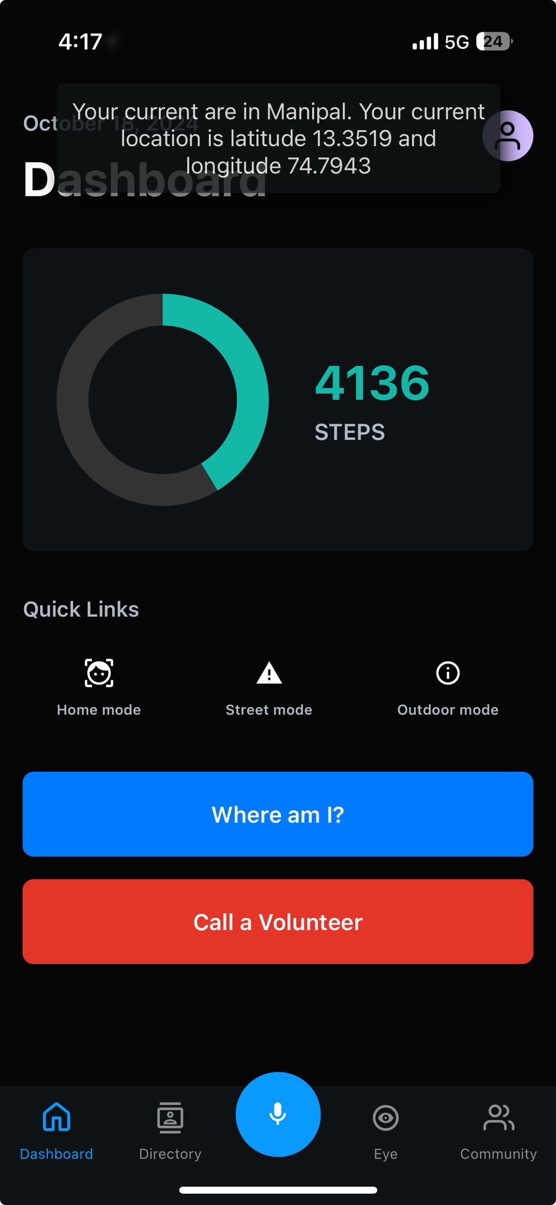
Location
Identification
Know Where You Are?
01
The app provides users with real-time information about their current location.

Slide 11
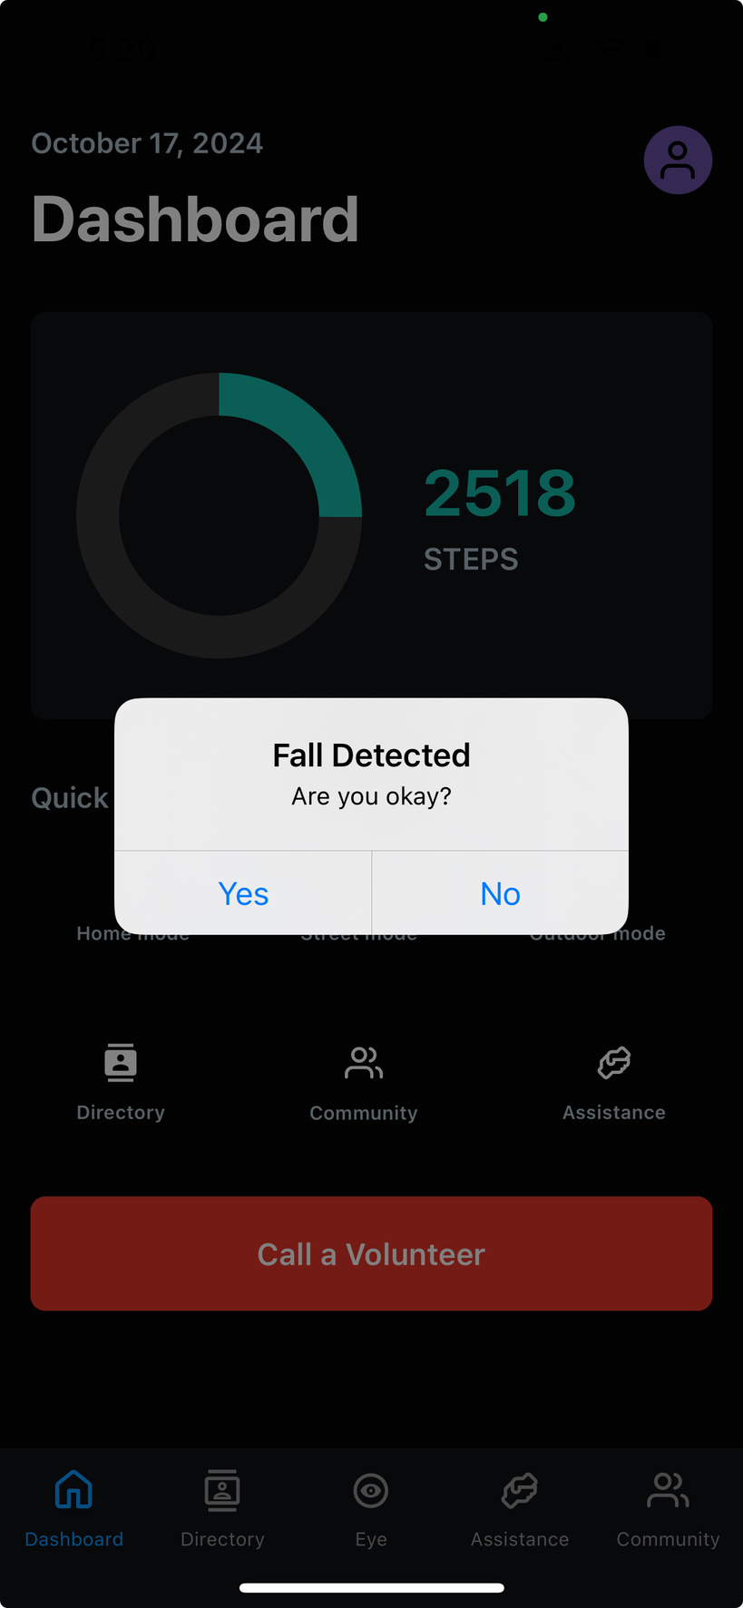
Fall Detection
Ensuring Safety at All Times
01
Uses accelerometer data to accurately detect sudden falls and abnormal movements.
02
Automatically sends SMS notifications to emergency contacts upon detecting a fall.
Provides real-time safety monitoring, ensuring timely assistance for users in case of accidents.
03

Slide 12
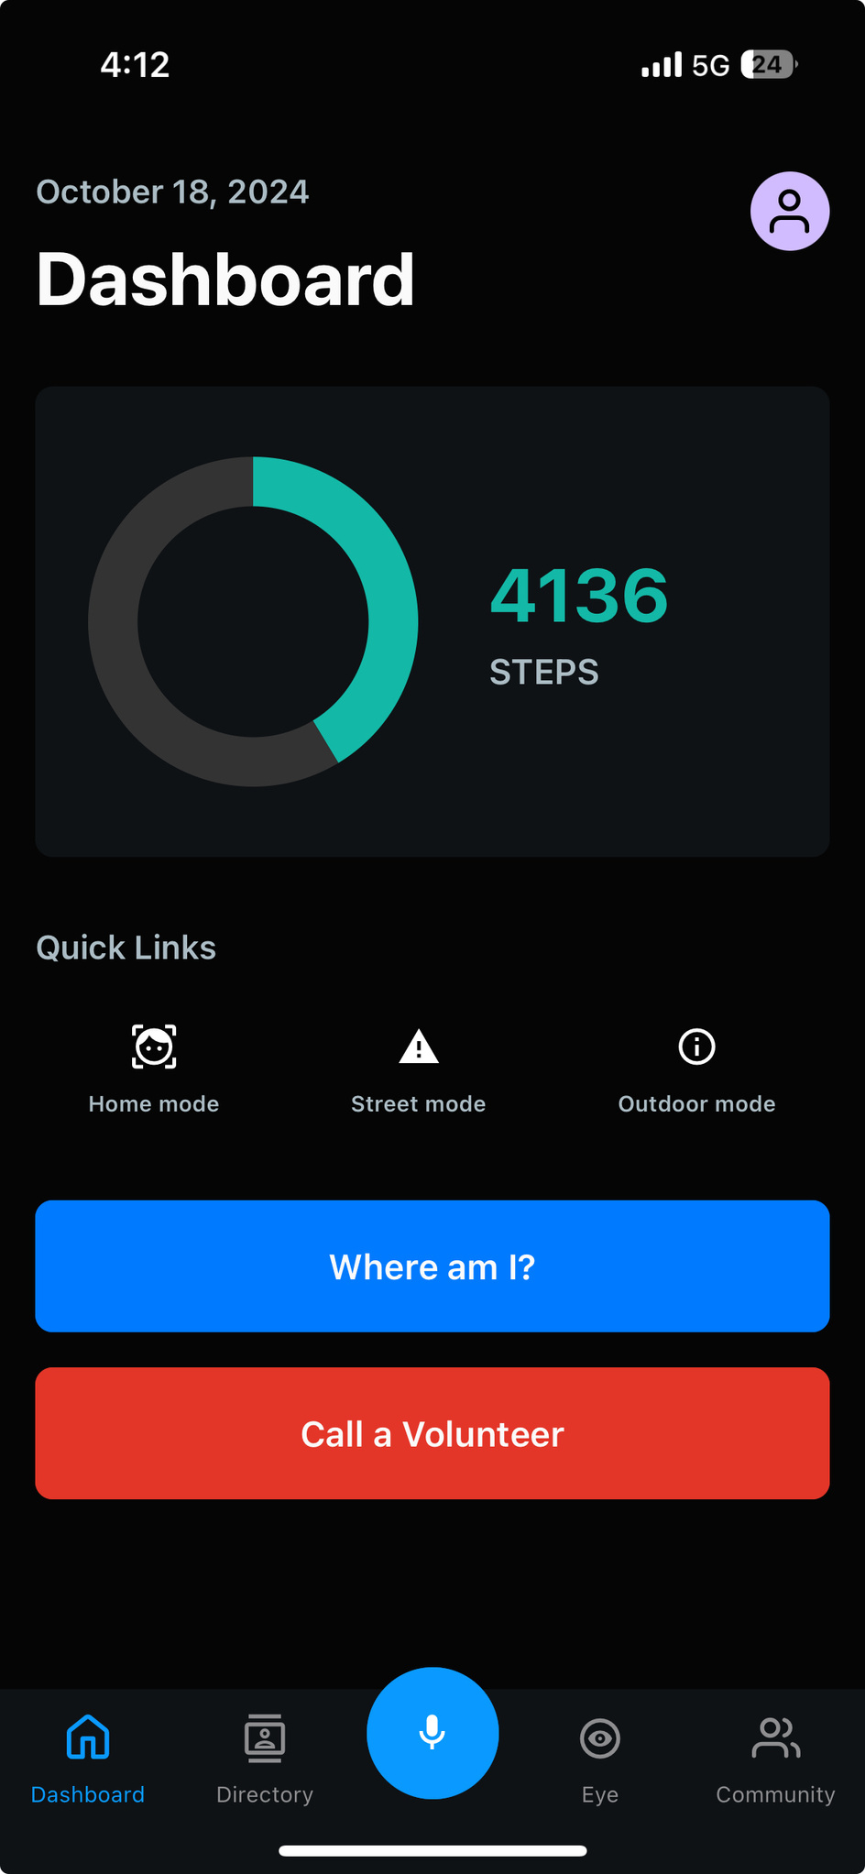
Step Count
Why Ignore health?
01
Displays step count on the app's dashboard, providing feedback on daily activity.

Slide 13
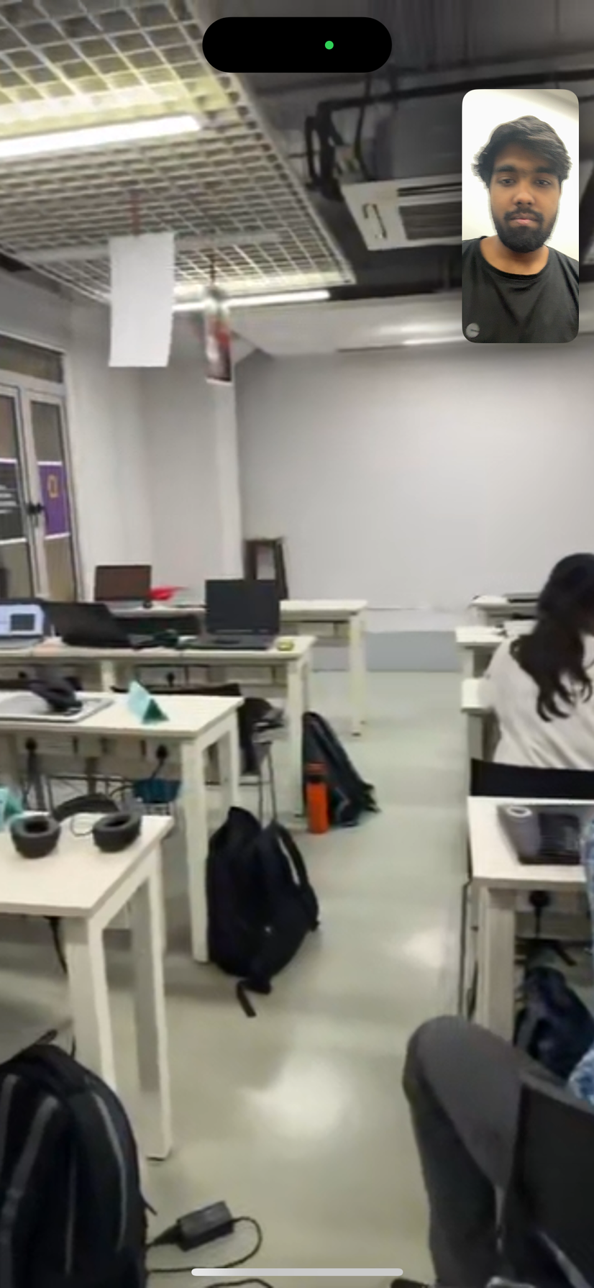
Assistive Video Calling
Get Instant Help!
01
Users can initiate assitive video calls to volunteers instantly in case of emergency
02
The app utilizes FaceTime for reliable, high-quality video communication with volunteers.
Volunteers provide instant guidance and assistance, ensuring immediate help when needed.
03

Slide 14
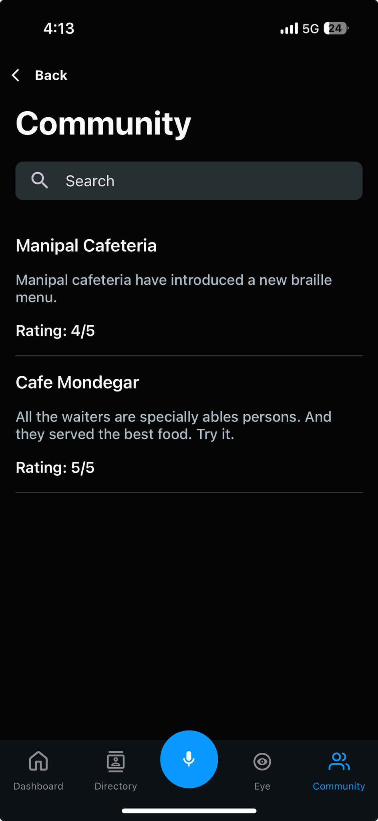
Community
Looking for accessible locations?
01
Provides a curated list of nearby venues and services. The user can identify and rate based on accessibily.

Slide 15
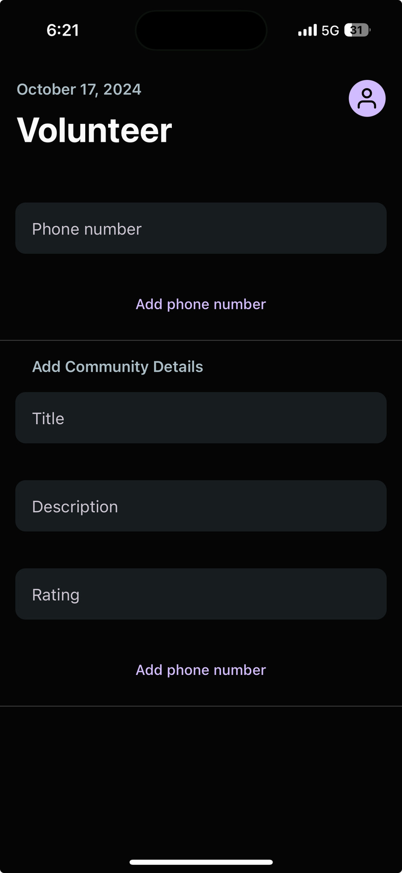
Any Volunteers?
Want to help others?
01
Separate profile for volunteers to offer real-time assistance to users in need.
02
Volunteers can respond to emergency calls and offer immediate support

Slide 16
Feature Overview
Indoor Mode (Face Recognition)
Fall Detection
Outdoor Mode (Object Recognition)
Health Updates
Street Mode (Depth Estimation)
Assistive Video Calling
Voice navigation for increased accessibiliy
Community Features
Location Identification
Haptic alerts

Slide 17
Business Model
Market Analysis
Freemium model
Market size
Free basic app with paid premium features like advanced recognition and offline depth estimation.
2.2B People with Vision Impairment Globally: ~36M blind, ~217M with severe impairment (WHO).
Subscription Plans
Pain Points
Monthly/yearly plans for unlimited recognition services and priority support (B2C).
Existing tools are slow and lack real time depth and multimodal feedback.
Partnerships
Assistive market growth
Collaborate with healthcare providers and NGOs to sponsor the app for their users (B2B).
Expected to hit $49.3B by 2026 (CAGR 7.4%)
Licensing
Target Audience
License the technology to other companies or assistive platforms for integration.
Visually impaired individuals and support organizations seeking independence with real-time recognition.

Slide 18
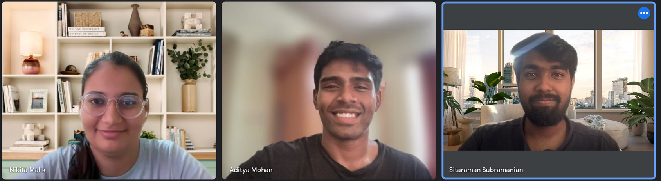
Our
Team
Nikita Malik
P Aditya Mohan
S Sitaraman

Slide 19
Thank
You

